Slide 1
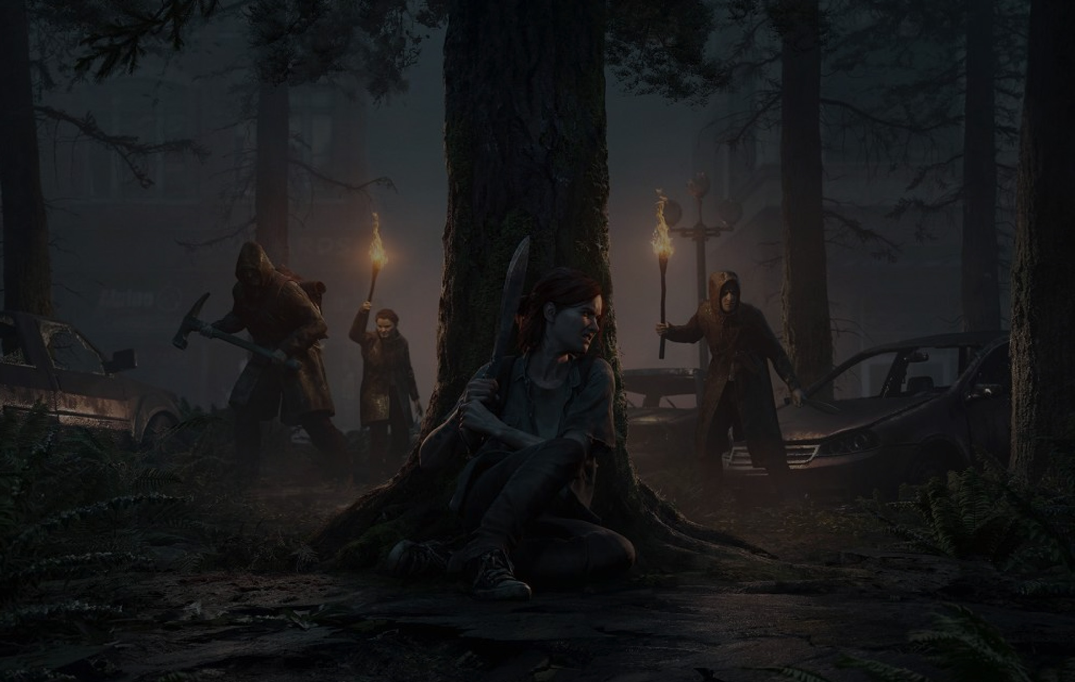
Motion Matching in TLOU2
A Data Driven Animation Approach
Notes:
Hello and Welcome!

Slide 2
Kan XU: Gameplay programmer from Naughty Dog.
Projects:
The Last of Us Part 2
Uncharted: The Lost Legacy
Uncharted 4: A Thief’s End
The Last of Us Remastered
The Last of Us Ps3
The Last of Us: Left Behind
Notes:
First let me introduce myself a little bit.
My name is Kan, I am gameplayer programmer from Naughty Dog.
The projects I worked on are:
The last of Us Part 2
Uncharted: The Lost Legacy
Uncharted 4.
And the original The Last of Us and PS4 remaster.

Slide 3
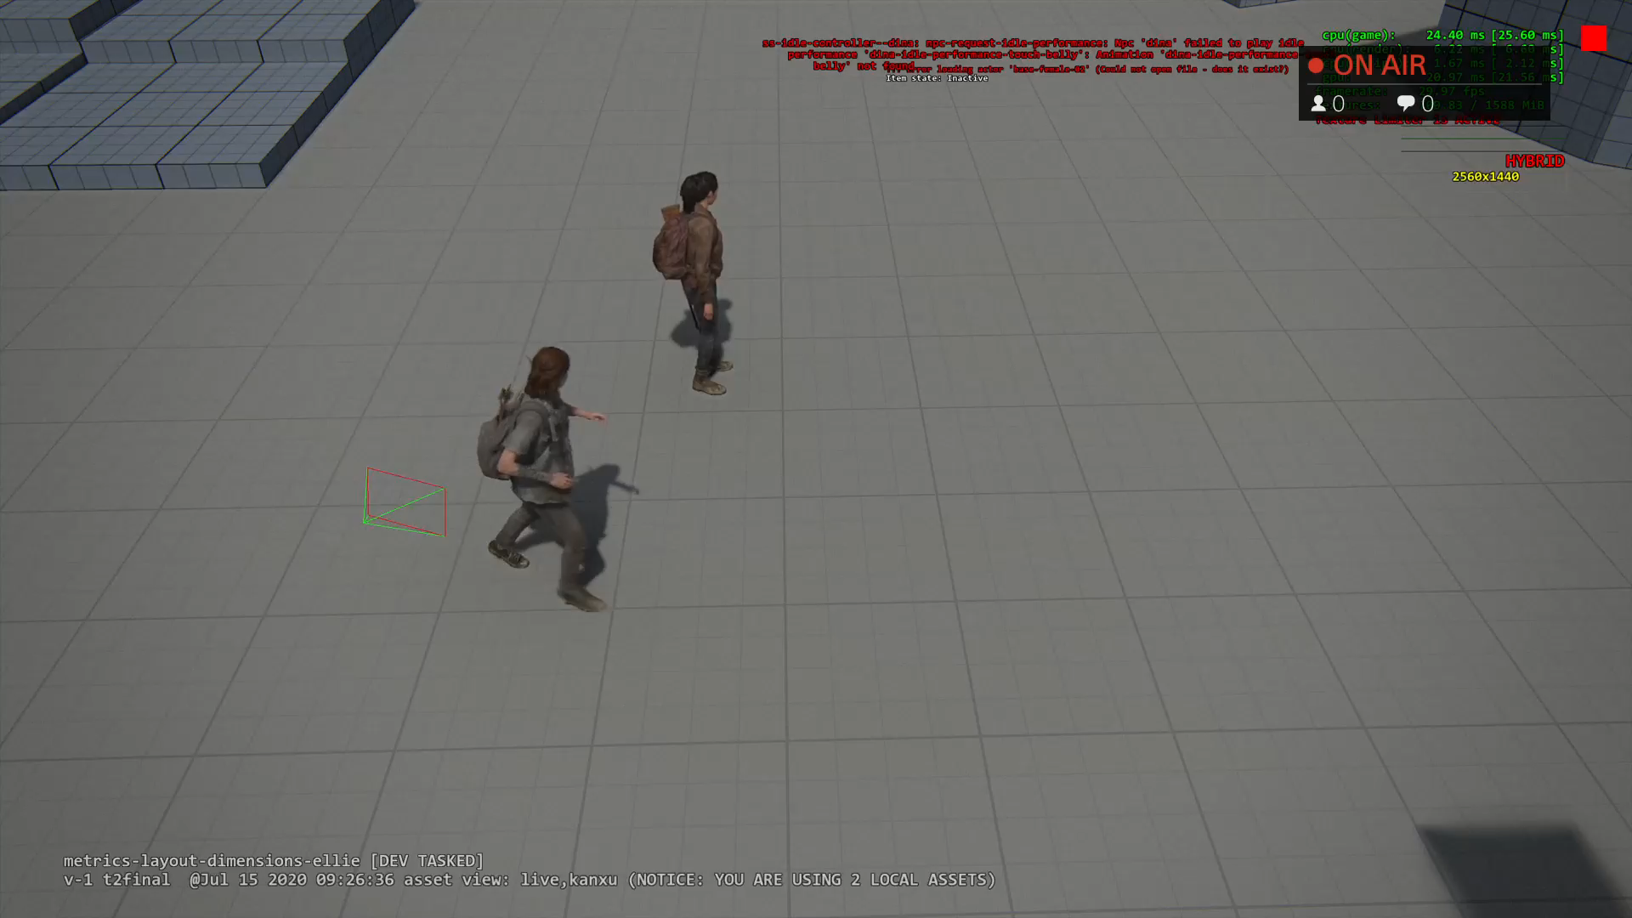
Strafing MM Demo
Notes:
Ok, back to our original topic: motion matching.
First let’s see what motion matching can do:
The last of Us Part 2 is a 3rd person shooter game.
Player is always strafing and she is always facing towards camera direction.
This video demonstrates how strafe locomotion works.
I am controlling Ellie using joystick to move her around and change direction a lot.
I can feel she is very responsive.
And also you will notice she does foot planting and weight shifting when changing direction.
Looks pretty nice.

Slide 4
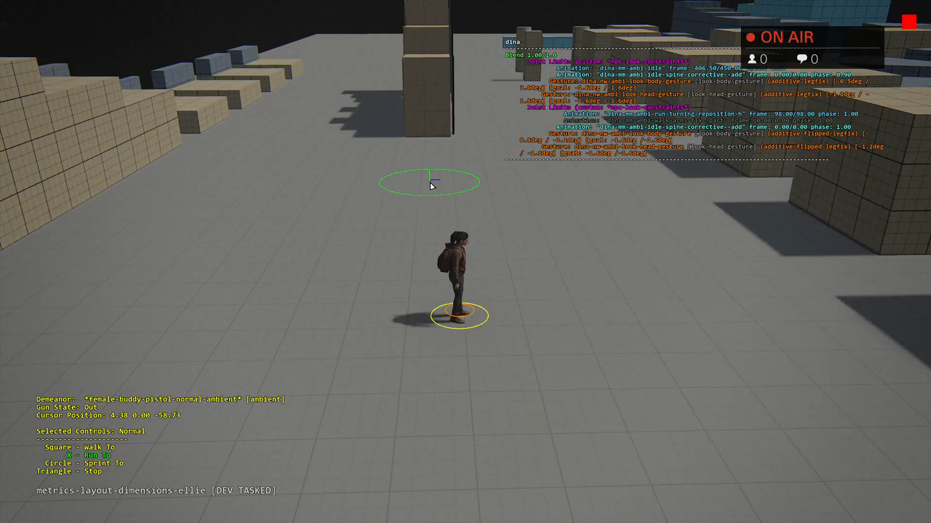
Non Strafing MM Demo
Notes:
Of course motion matching can work with non strafing locomotion.
This is Buddy Npc Dina. I am using mouse to move her around.
You will notice foot planting, weight shifting when she changes direction too.

Slide 5
Traditional animation system
Blend tree and parametric blending
Layering
State machines
Phase matching
Notes:
Before we dig into Motion Matching, let’s take a quick look at the traditional animation system first.
This will give us motivation why do we need motion matching.
Current-Gen video games usually need the following tools to reach AAA quality:
…
Let’s take a look at each tool.

Slide 6
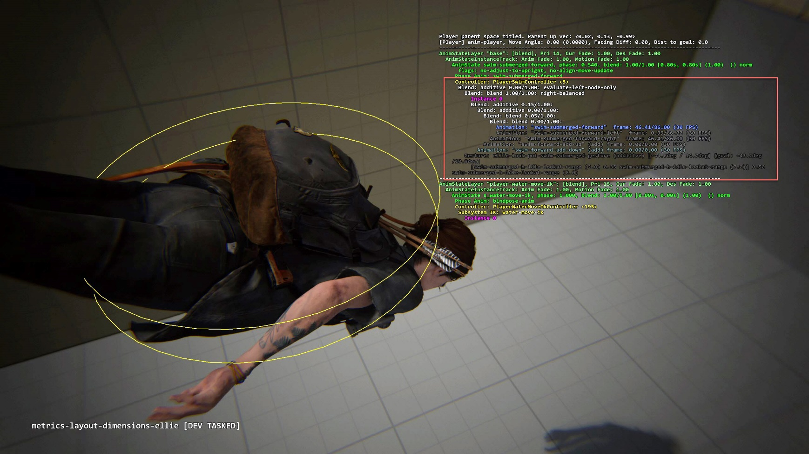
Blend tree and parametric blending
Notes:
Blend tree and parametric blending:
[TODO]: Maybe change to video?
This is a screenshot Ellie swim underwater.
It’s single animation state but it has 5 animations blended as a tree.
One Forward animation as base, plus 4 additive animations including up, down, left and right.
When she slightly changes direction, programmer need change additive animation blend weight.
These additive animations will add subtle details which makes turning around looks more natural.

Slide 7
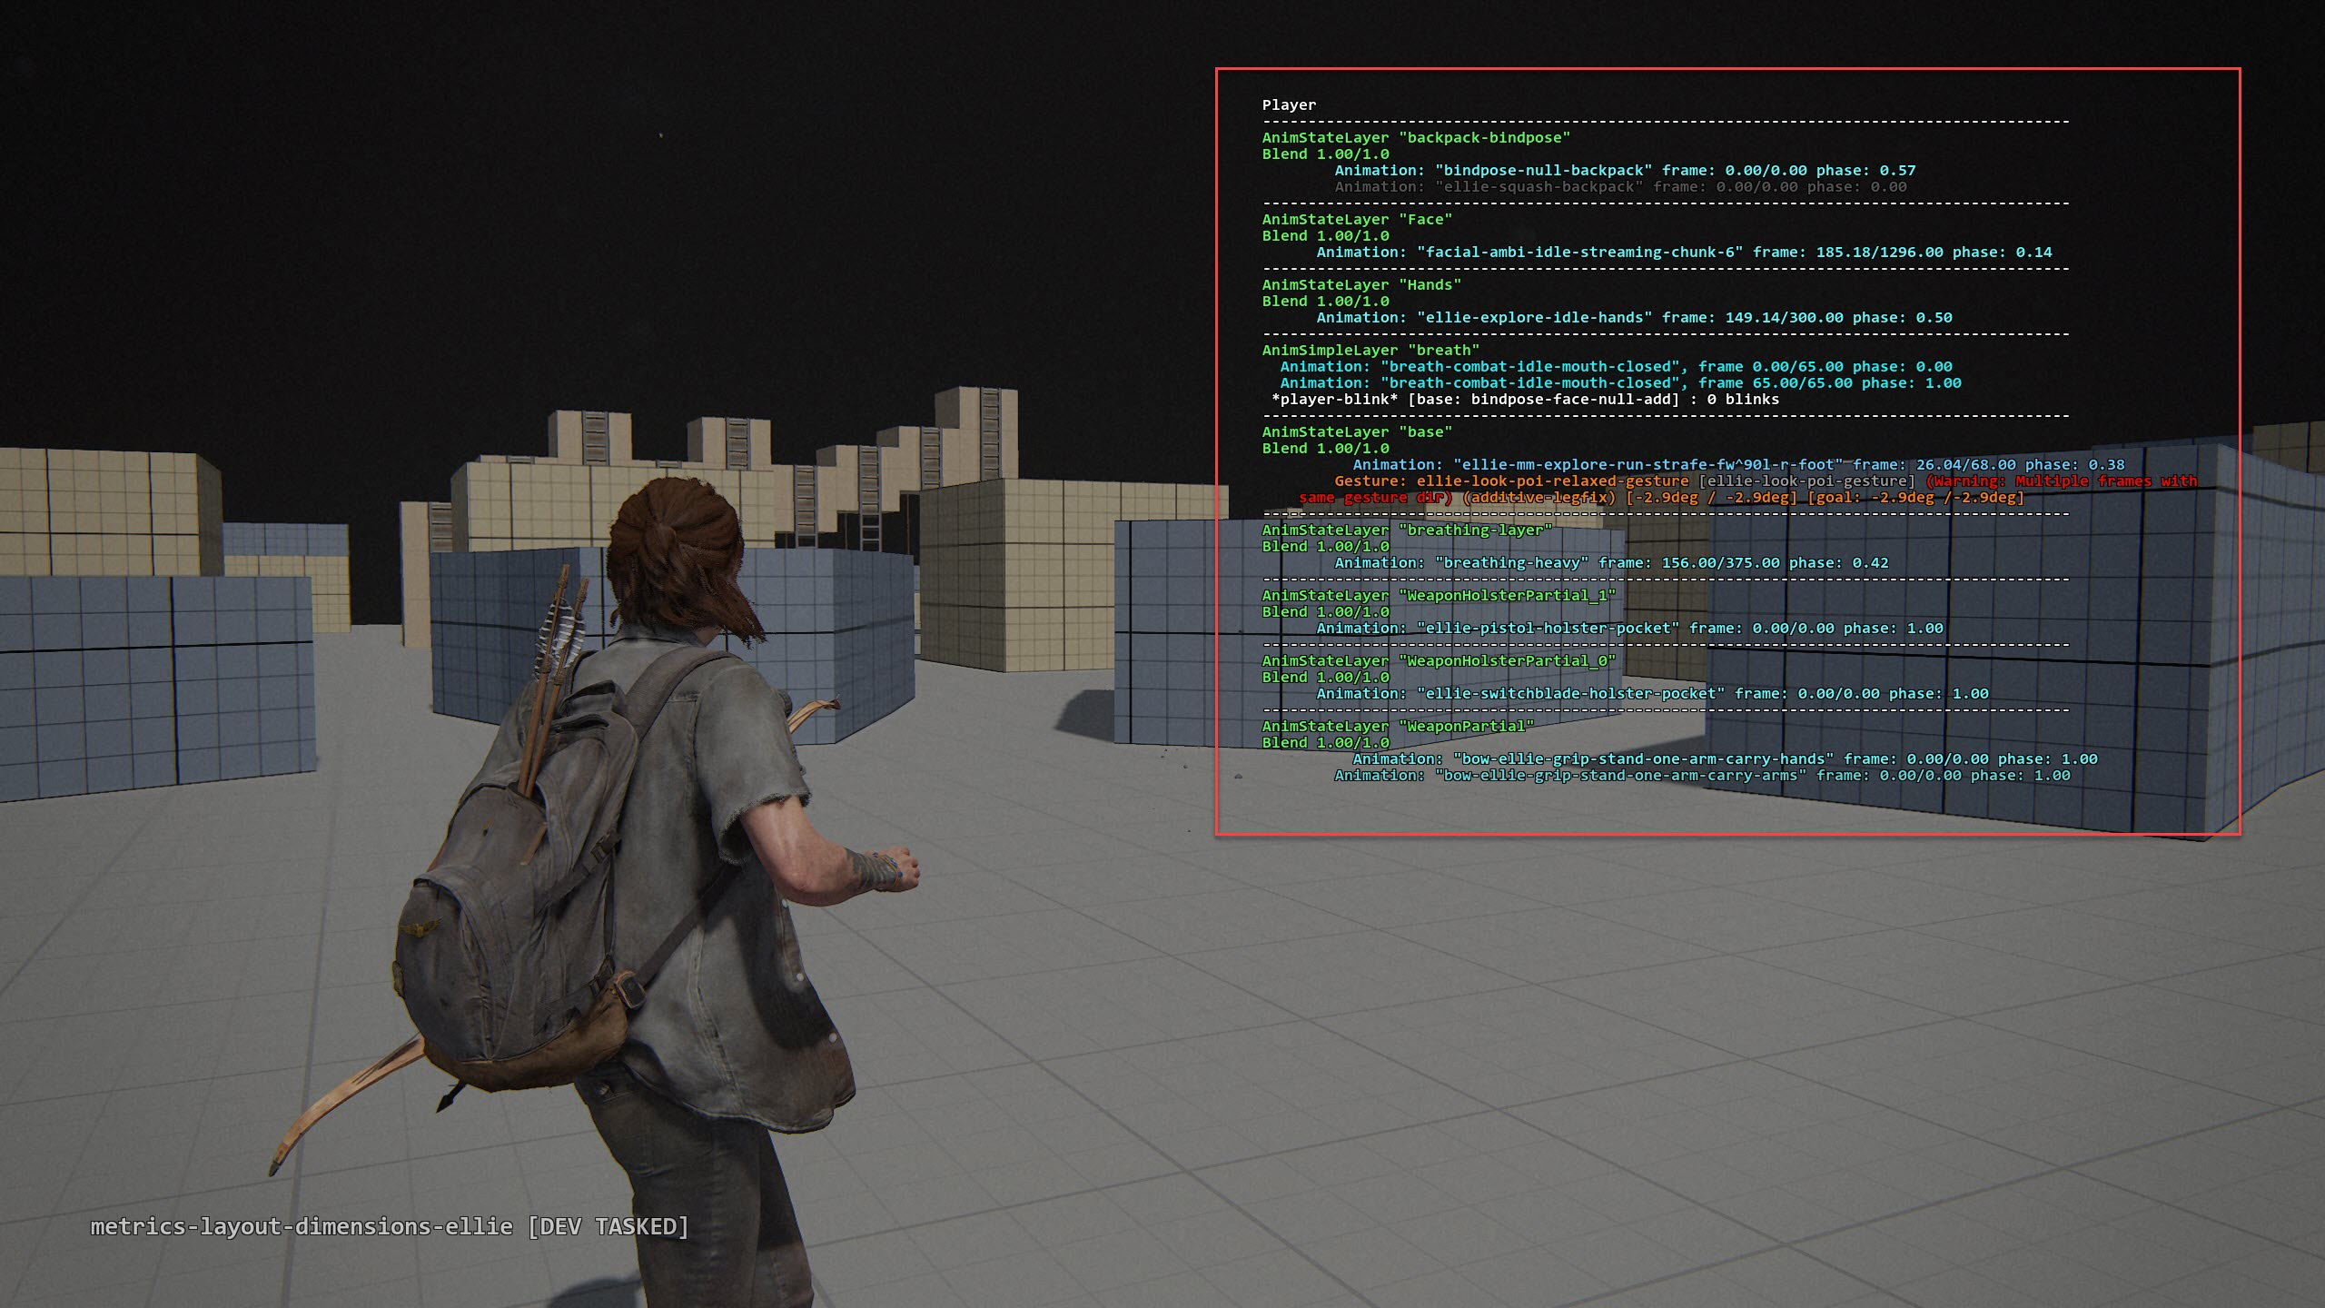
Layering
Notes:
Layering
The next thing is layering.
Player can have up to 60 anim layers. But not of them running all the time.
This is a screenshot Ellie’s running around with her bow out.
Some of the key layers are:
Base layer, it’s for locomotion. This is implemented by motion matching.
Face layer, it’s facial animation
Breath layer, it’s for breath and heart beating.
Weapon Layer: it’s for holding the weapon, switch weapon and reload, etc.

Slide 8
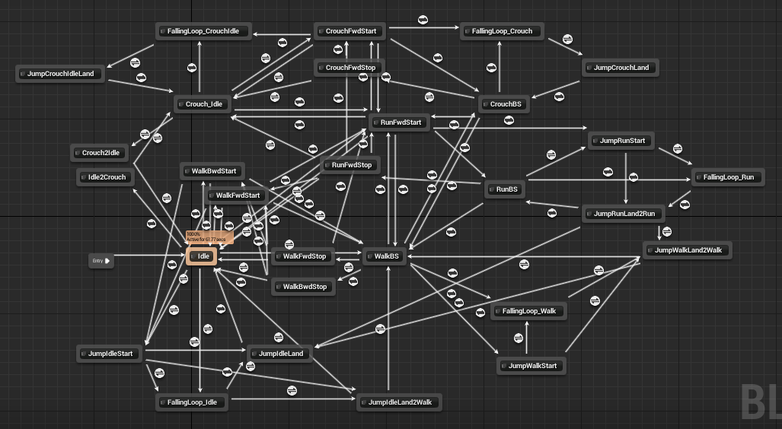
Animation State Machine
Notes:
Animation state machine:
This is a screenshot of unreal locomotion state machine.
We can see there’s many states and many transitions here.
Let’s say animator wants to add a sharp turn animation from left to right, programmer needs add a new “sharp turn” state and a few transitions to fix the links.
The more detailed animators want, the more states and transitions programmers need manage.
Of course it will become very complicated for AAA game.

Slide 9
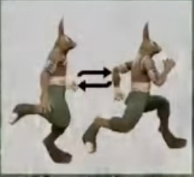
Phase matching
Animator need do a lot tagging.
Foot pass
Foot reach
Notes:
State machine solves the problem of which animation to play.
Another problem is which frame to start.
The comes “Phase matching”:
The idea is given the current pose, we need find a similar pose in the next anim.
To do this: animators need do a lot tagging:
Usually they need tag left foot passes right foot, left foot reaches the ground, right foot passes left foot, right foot reaches the ground.
So gameplay code can find the similar pose by comparing foot event.
It’s a boring and repetitve job for animators

Slide 10
Drawback of traditional system
Code: Complexity
Huge web of state-machine
Lots of layers
Hard to implement transitions (lose fidelity)
For Animators:
Lots of tagging for phase matching
Notes:
I am sure you already see problems with traditional system.
Giant state machine is hard to maintain, also very hard to add new feature.
Lot of layers. It’s not too bad but we still want to reduce the number of layers.
Hard to implement transitions. It’s extremely hard to implement things like sharp turn in the middle of another sharp turn.

Slide 11
Motivation
There’s a lot details presented in mocap data:
Change directions
Foot planting
Weight shifting
Notes:
So all these drawbacks leads us to motion matching.
If we look at the raw mocap data:
We see a lot of fine details:
***
Those are hard to be implemented but it’s there.
How can we extract them?

Slide 12
Motivation (cont.)
Let’s forget about state machines, blend-tree, etc.
Why not think mocap data as a pose database?
Notes:
Let’s forget about the old techniques for a while.
Why not think mocap data as a collection of poses, or a big pose database.
And given character’s current pose, why not try find the best matching one from this database?

Slide 13
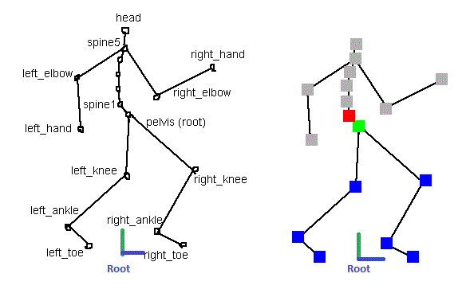
Terminology
Animation Rig
Animated Hierarchy
Root
Root motion
Notes:
Before getting to that database idea, let’s first talk about terminology so everyone is on the same page.
This is simplified animation rig.
The pelvis is root, it has 3 children: spine1, left_knee, right_knee.
Each child node can have child too. For example, left_knee has child left_ankle, left_ankle has child node left_toe.
Since it’s a tree structure we can also call it animated hierarchy.
The root is another locator usually the center of 2 feet. It’s for determine character location on the ground.
When we talk about root motion, we are talking about movement of root locator.

Slide 14
The desired trajectory
Gameplay code can provide a desired trajectory
For player, we can convert joypad input to trajectory
For NPC, his navigation path is desired trajectory naturally
Notes:
Back to motion matching.

Slide 15
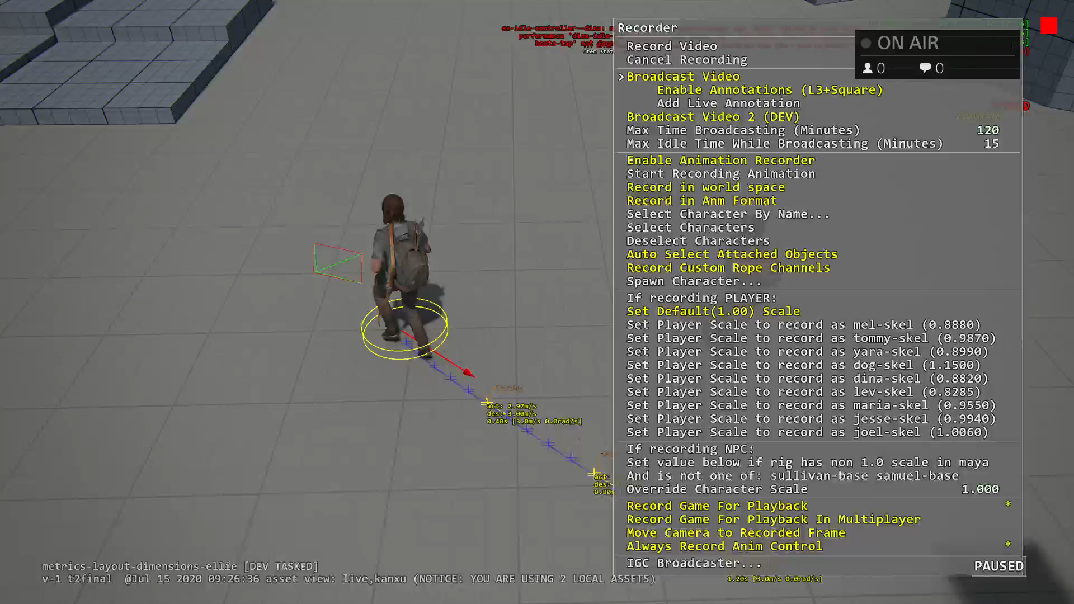
Desired trajectory from gameplay
Notes:
This video shows how to get a desired trajectory for player.
Here the red arrow is my joypad stick input.
Assume player doesn’t change input for 1 second, with character’s current velocity, plus some spring and I can easily generate a desired trajectory.

Slide 16
Match the desired trajectory
Start with simple, let’s try match the desired trajectory first.
Notes:
Let’s start something simple: try match the desired trajectory first.

Slide 17
Trajectory from a pose
For each animation, it has a root trajectory
Each pose in animation can look ahead and back to get root trajectory
Notes:
Need a video to demonstrate “trajectory from a pose”

Slide 18
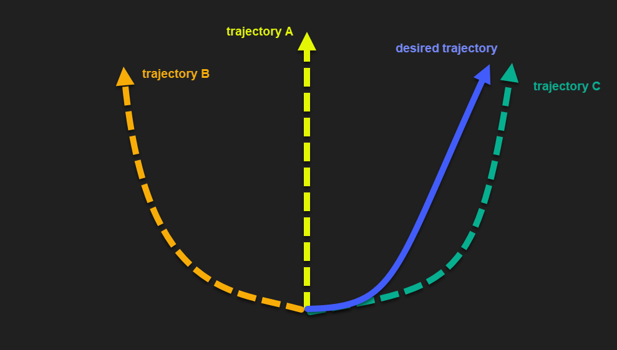
Matching Trajectory Curves
Calculate its “distance” between the desired trajectory.

Slide 19
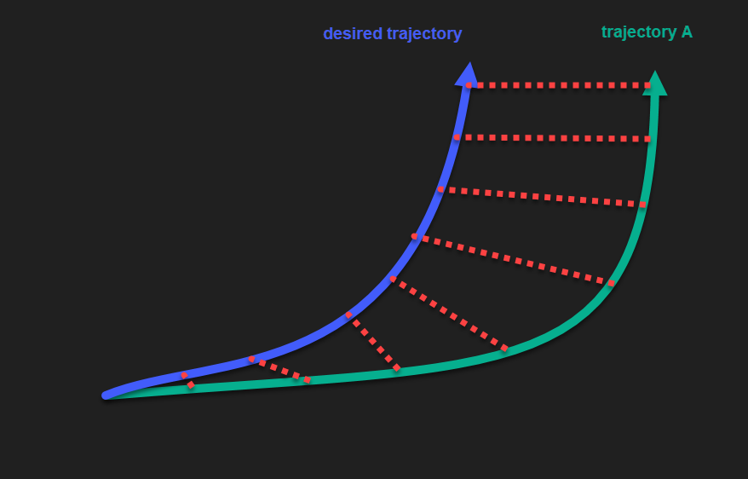
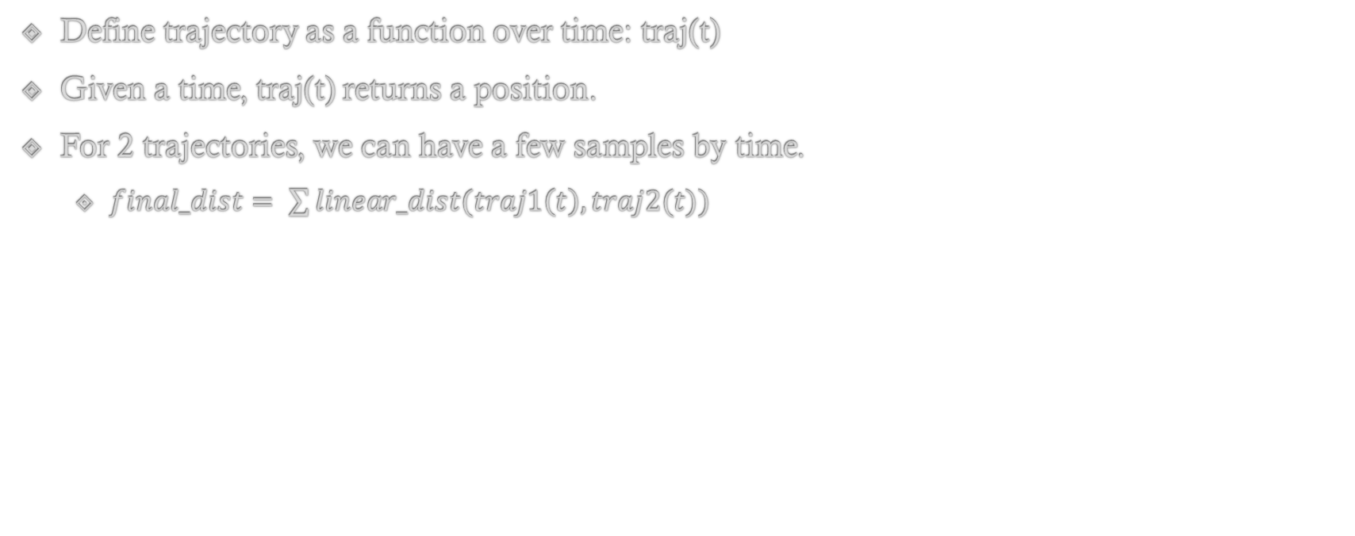
“Distance” between 2 Trajectories
Define trajectory as a function over time: traj(t)
Given a time, traj(t) returns a position.
For 2 trajectories, we can have a few samples by time.
$final_dist= \sum{linear_dist(traj1\left(t\right), traj2(t))}$

Slide 20
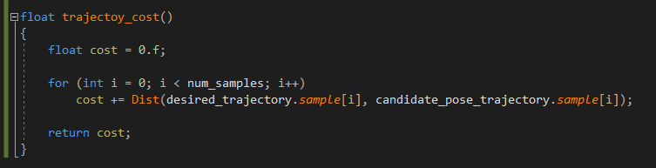
Pseudo code

Slide 21
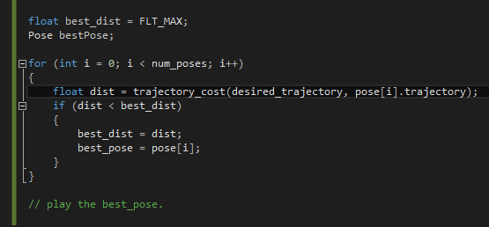
First algorithm
Given player explore locomotion set:
183 animations
8866 poses
First algorithm:
Notes:
Here: desired_trajectory is global space, pose[i].trajectory is root space
We need transform desired_trajectory into root space

Slide 22
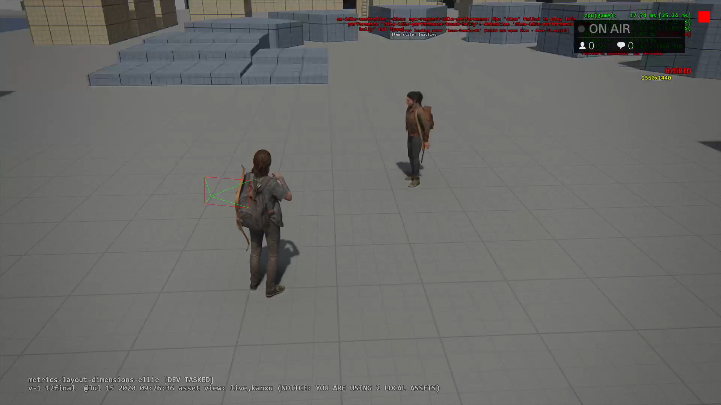
Result of matching desired trajectory only
Notes:
Player can follow my joypad input very well. However she is not animating correctly.

Slide 23
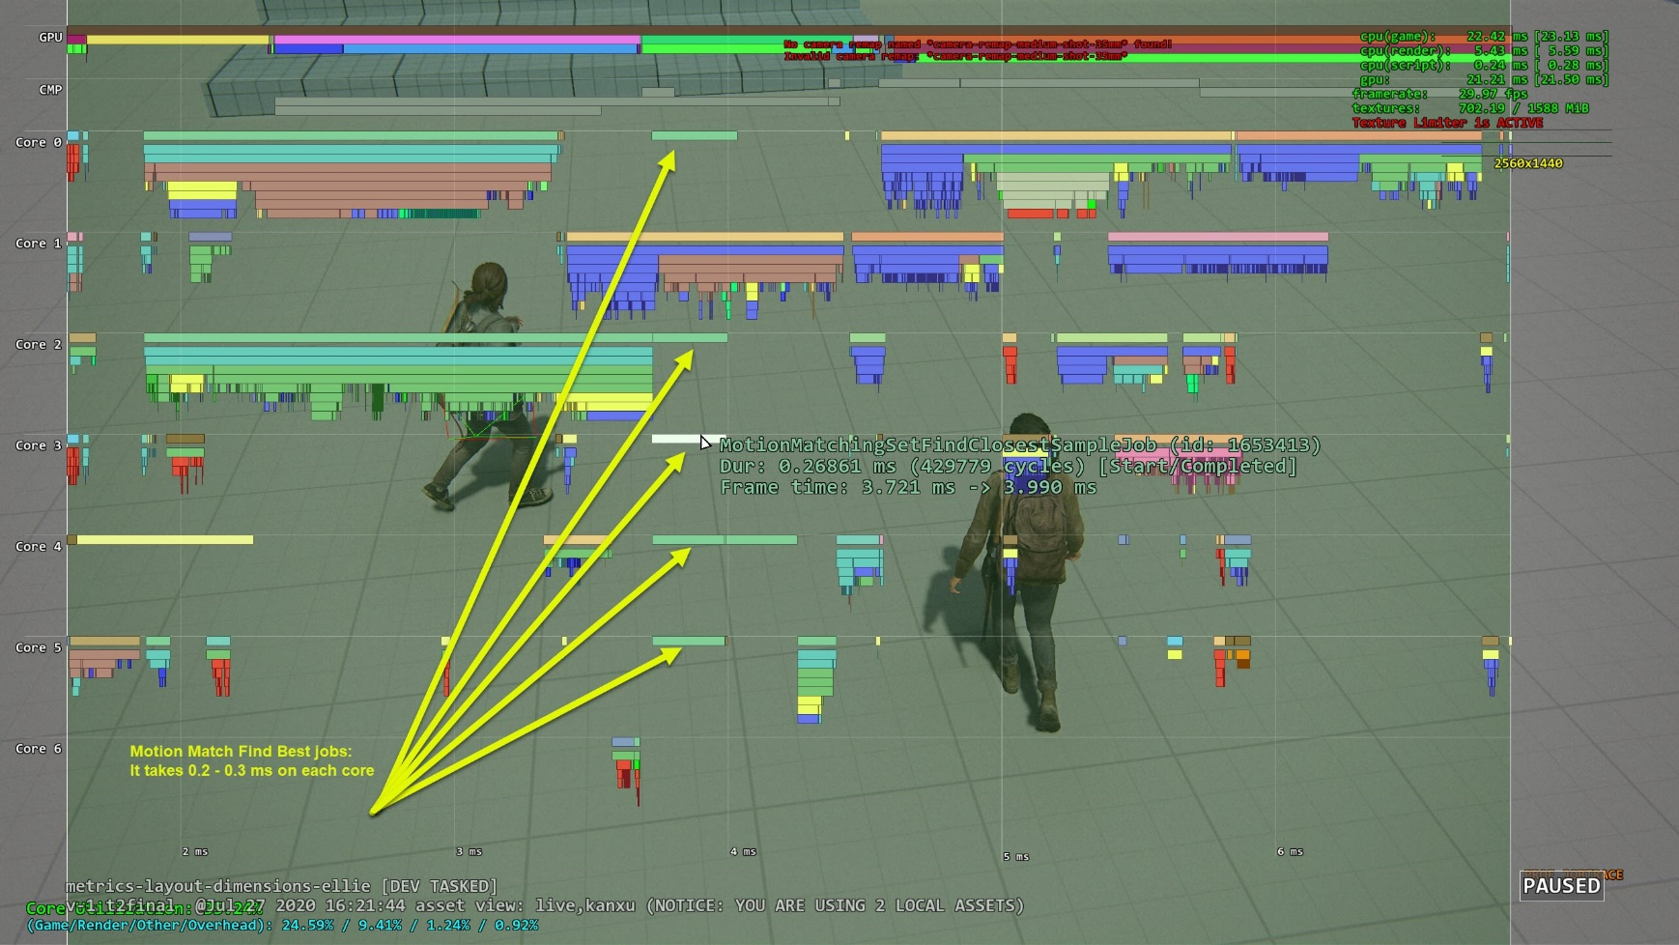
Performance of brute force algorithm

Slide 24
We have problems
Matching trajectory only doesn’t play animation at all.
It feels character is stuck.
Brute force algorithm is expensive:
With 8866 poses trajectories calculated at loading time and cached.
For one character, it takes 0.3ms on each core. (6 cores total)
It scales up linearly by number of characters.
Notes:
The last of us part 2 can have maximum 16 active npcs anytime.

Slide 25
Pose Matching
We need also add “pose” into consideration too.
What’s a “pose”?
A pose is a list of joints. Each joint has 2 key features:
Position
Velocity
Notes:
Let’s solve the first problem:

Slide 26
Difference between 2 poses
Pose difference can be defined as:
Dist(PoseA.Pos, PoseB.Pos) * Weight_Pos + Dist(PoseA.Vel, PoseB.Vel) * Weight_Vel
We don’t need compare all joints, we just need most relevant joints:
L_ankle, R_ankle, Spine for biped locomotion

Slide 27
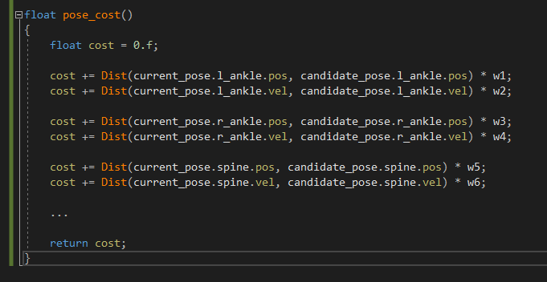
Pseudo code

Slide 28
Second cost function
New cost function:
How good a candidate pose’s trajectory matches the desired trajectory
+
How good a candidate pose matches character’s current pose

Slide 29
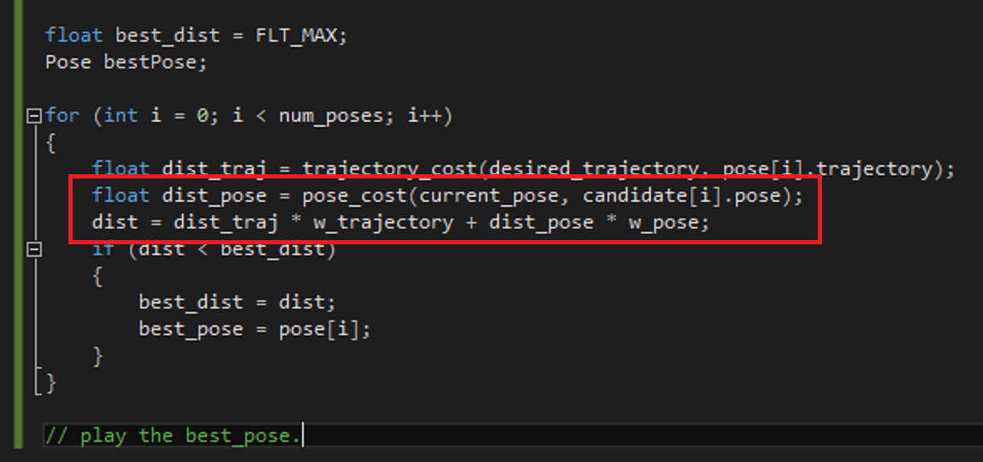
Second Algorithm
Trajectory cost and pose matching cost are different units:
Need a weight to combine them
Second algorithm:

Slide 30
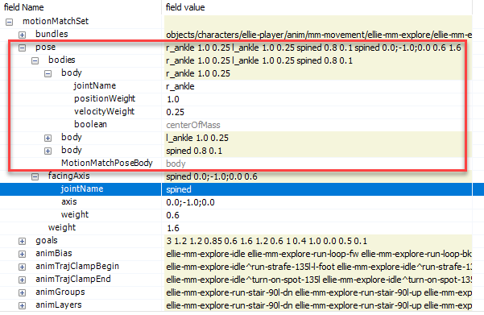
Pose weights
Notes:
After some time tuning, here’s some pose weights for player strafe set.

Slide 31
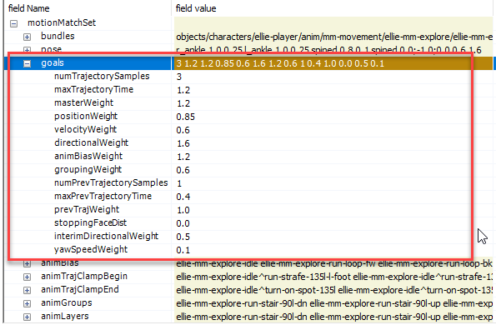
Trajectory weights
Notes:
Here’s some weights for trajectory.

Slide 32
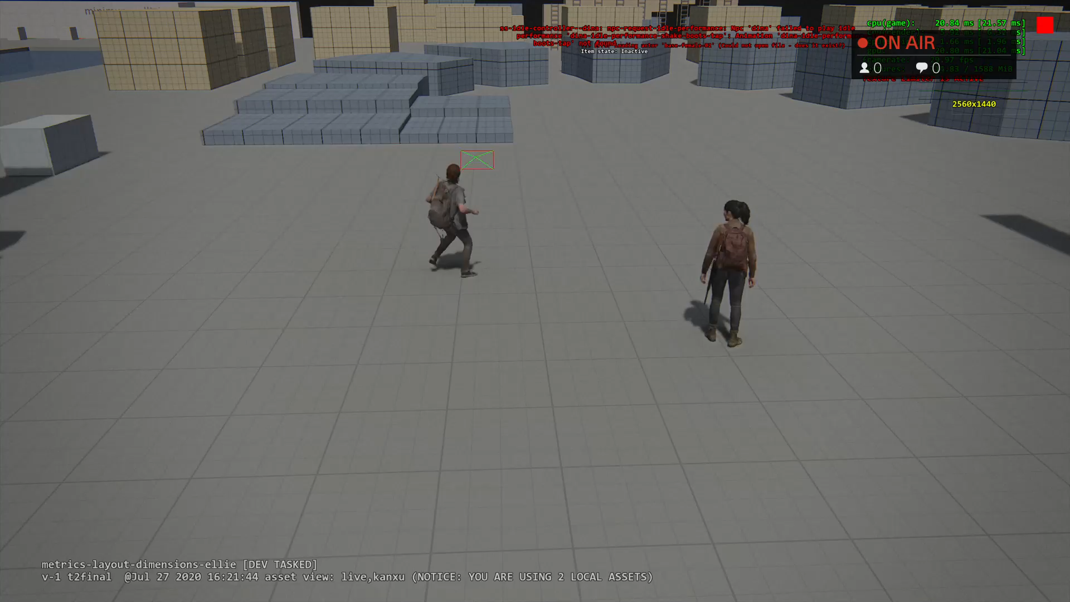
Result of pose matching

Slide 33
Optimization
Brute force search all candidate poses are bad.
First Idea: Run cost function on GPU:
Compute shader to compute cost.
Another shader to reduce and find the best match.
Downside:
Kick compute job onto GPU and wait for result has latency.
MM needs be finished before animating character at the same frame.
Notes:
Kick compute job onto GPU has latency:
We have many other compute jobs running at the same time. For example:
mesh raycaster: we shoot a bunch rays to renderable geometry. It’s for bullet decal, blood effect, character feet IK, etc.
AI exposure map: It’s for know how much space around player is exposed to enemy. So buddy can find a safe route to sneak around.
All those compute jobs are kicked this frame, but we use the results next frame.
However MM must finish earlier…

Slide 34
Question: Can we run MM on CPU only?

Slide 35
Look at the data
Each Pose:
3 joints (l_ankle, r_ankle, spine) + 1 facing direction (strafing).
(3 * (kPosCount + kVelCount)) + kFacingCount => 21 floats
4 trajectory samples:
(4 * (kPosCount + kVelCount + kFacingCount + kYawSpeedCount)) => 40 floats
Combine them, each pose is a 61dimension vector.
Notes:
Npc has the same dimension.

Slide 36
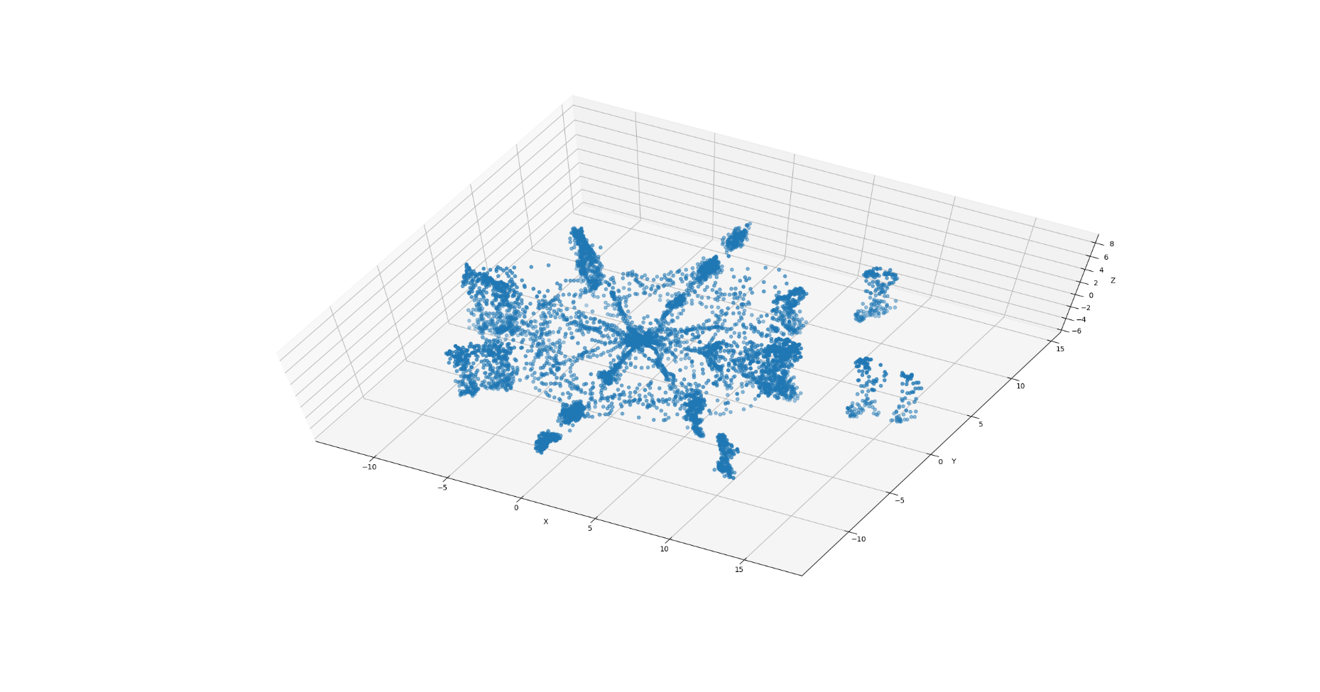
Plot the data
Notes:
8866 poses totally
Each point is a pose: 61 dimension vectors.
For visualization purpose, use Primary Component Analysis to reduce dimension to 3 so I can plot them using 3D space.

Slide 37
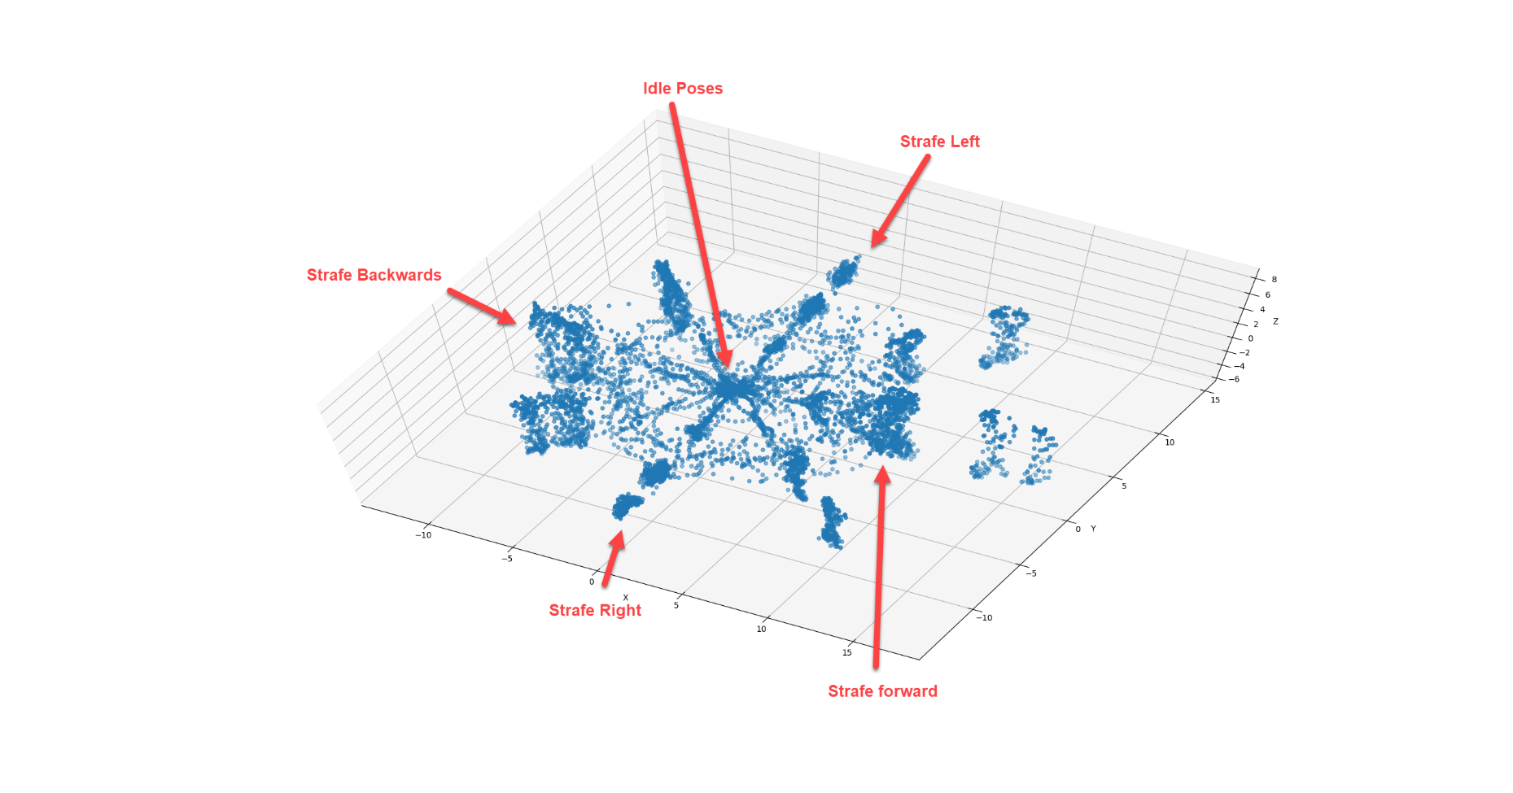
Plot the data
Notes:
What do we find here is similar trajectories trends to be close.

Slide 38
Learn from the data
Similar trajectories trends to be closer
It’s a waste to search poses (points) which are far from desired point.
Notes:
For example:
If character is moving right, we only want to search moving right trajectories.
There’s no point to search idle poses, moving backward or forward trajectories.

Slide 39
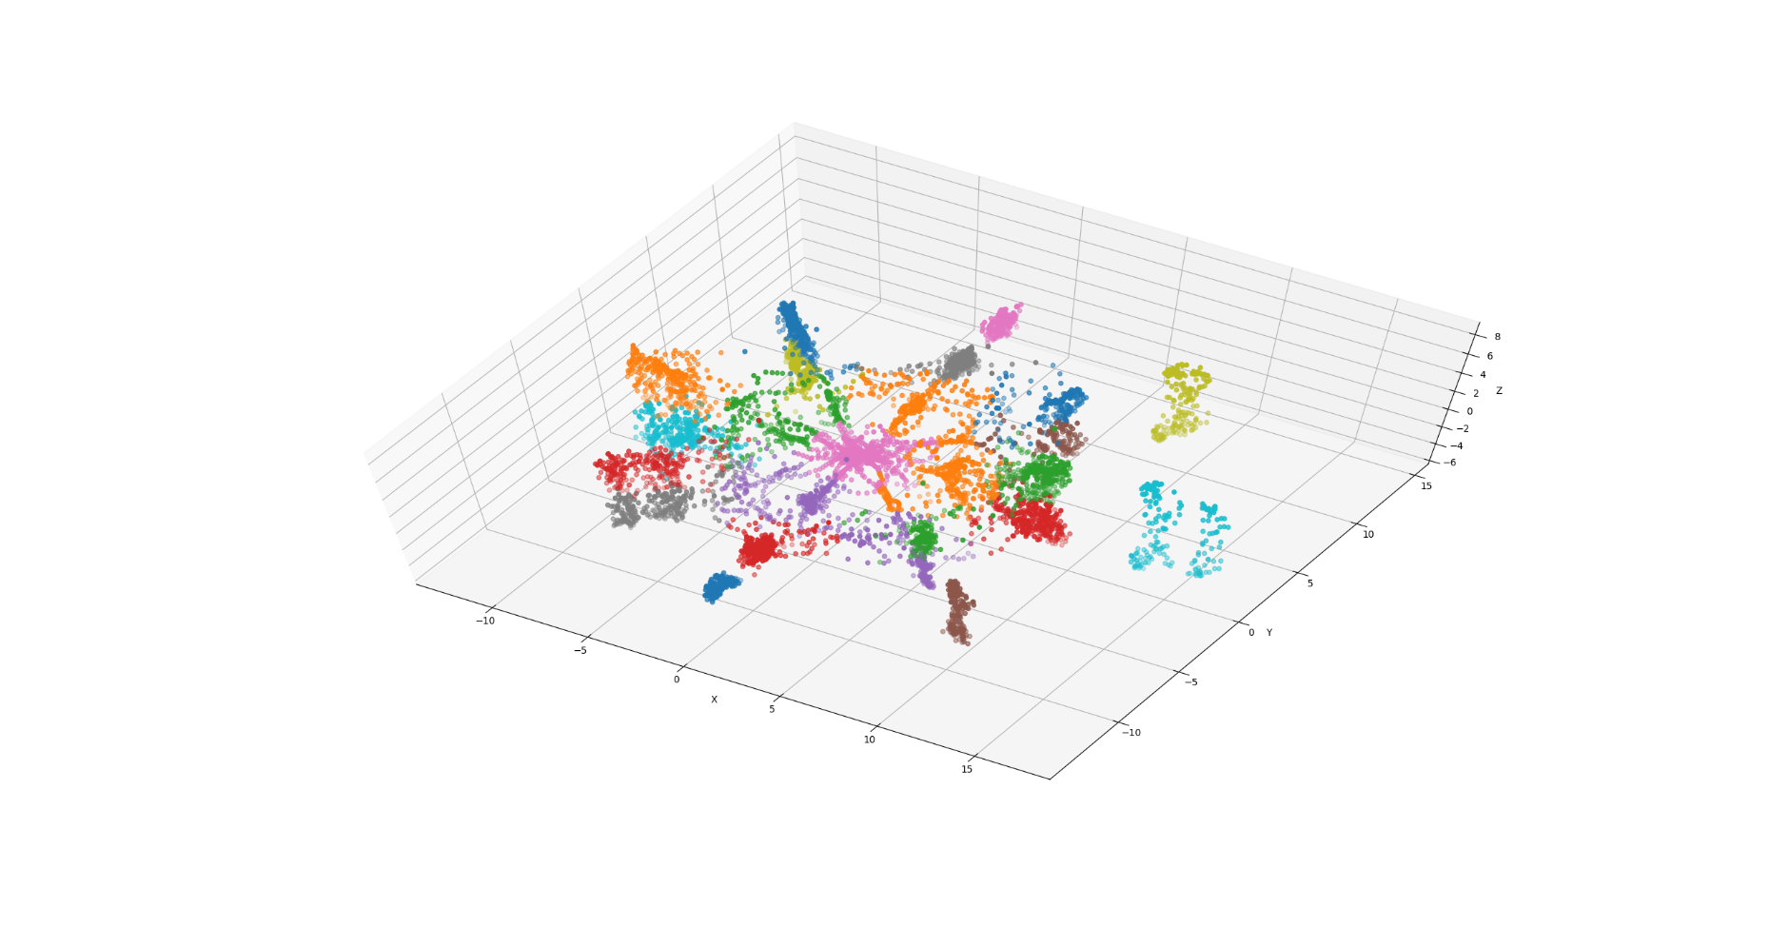
Cluster the data (KMean) offline
Notes:
Cluster the data using KMean.
Then build a bounding sphere for each cluste’s mean.

Slide 40
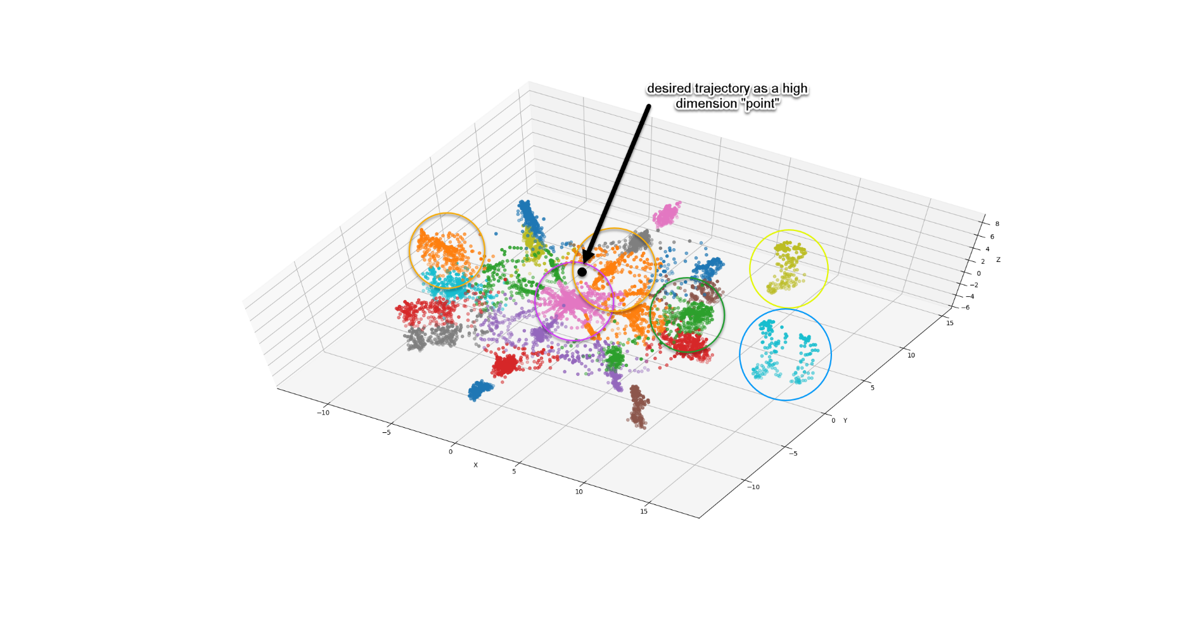
Bound spheres
Notes:
The next step is to build a bounding sphere for each cluster.
Given a desired trajectory, it’s also a high dimension point in this 3d graph.

Slide 41
Run time code
Run time code find desired trajectory “point” is inside which cluster bounding sphere.
Only search best match pose in those intersecting clusters.
Notes:
The key is to reduce search space.

Slide 42
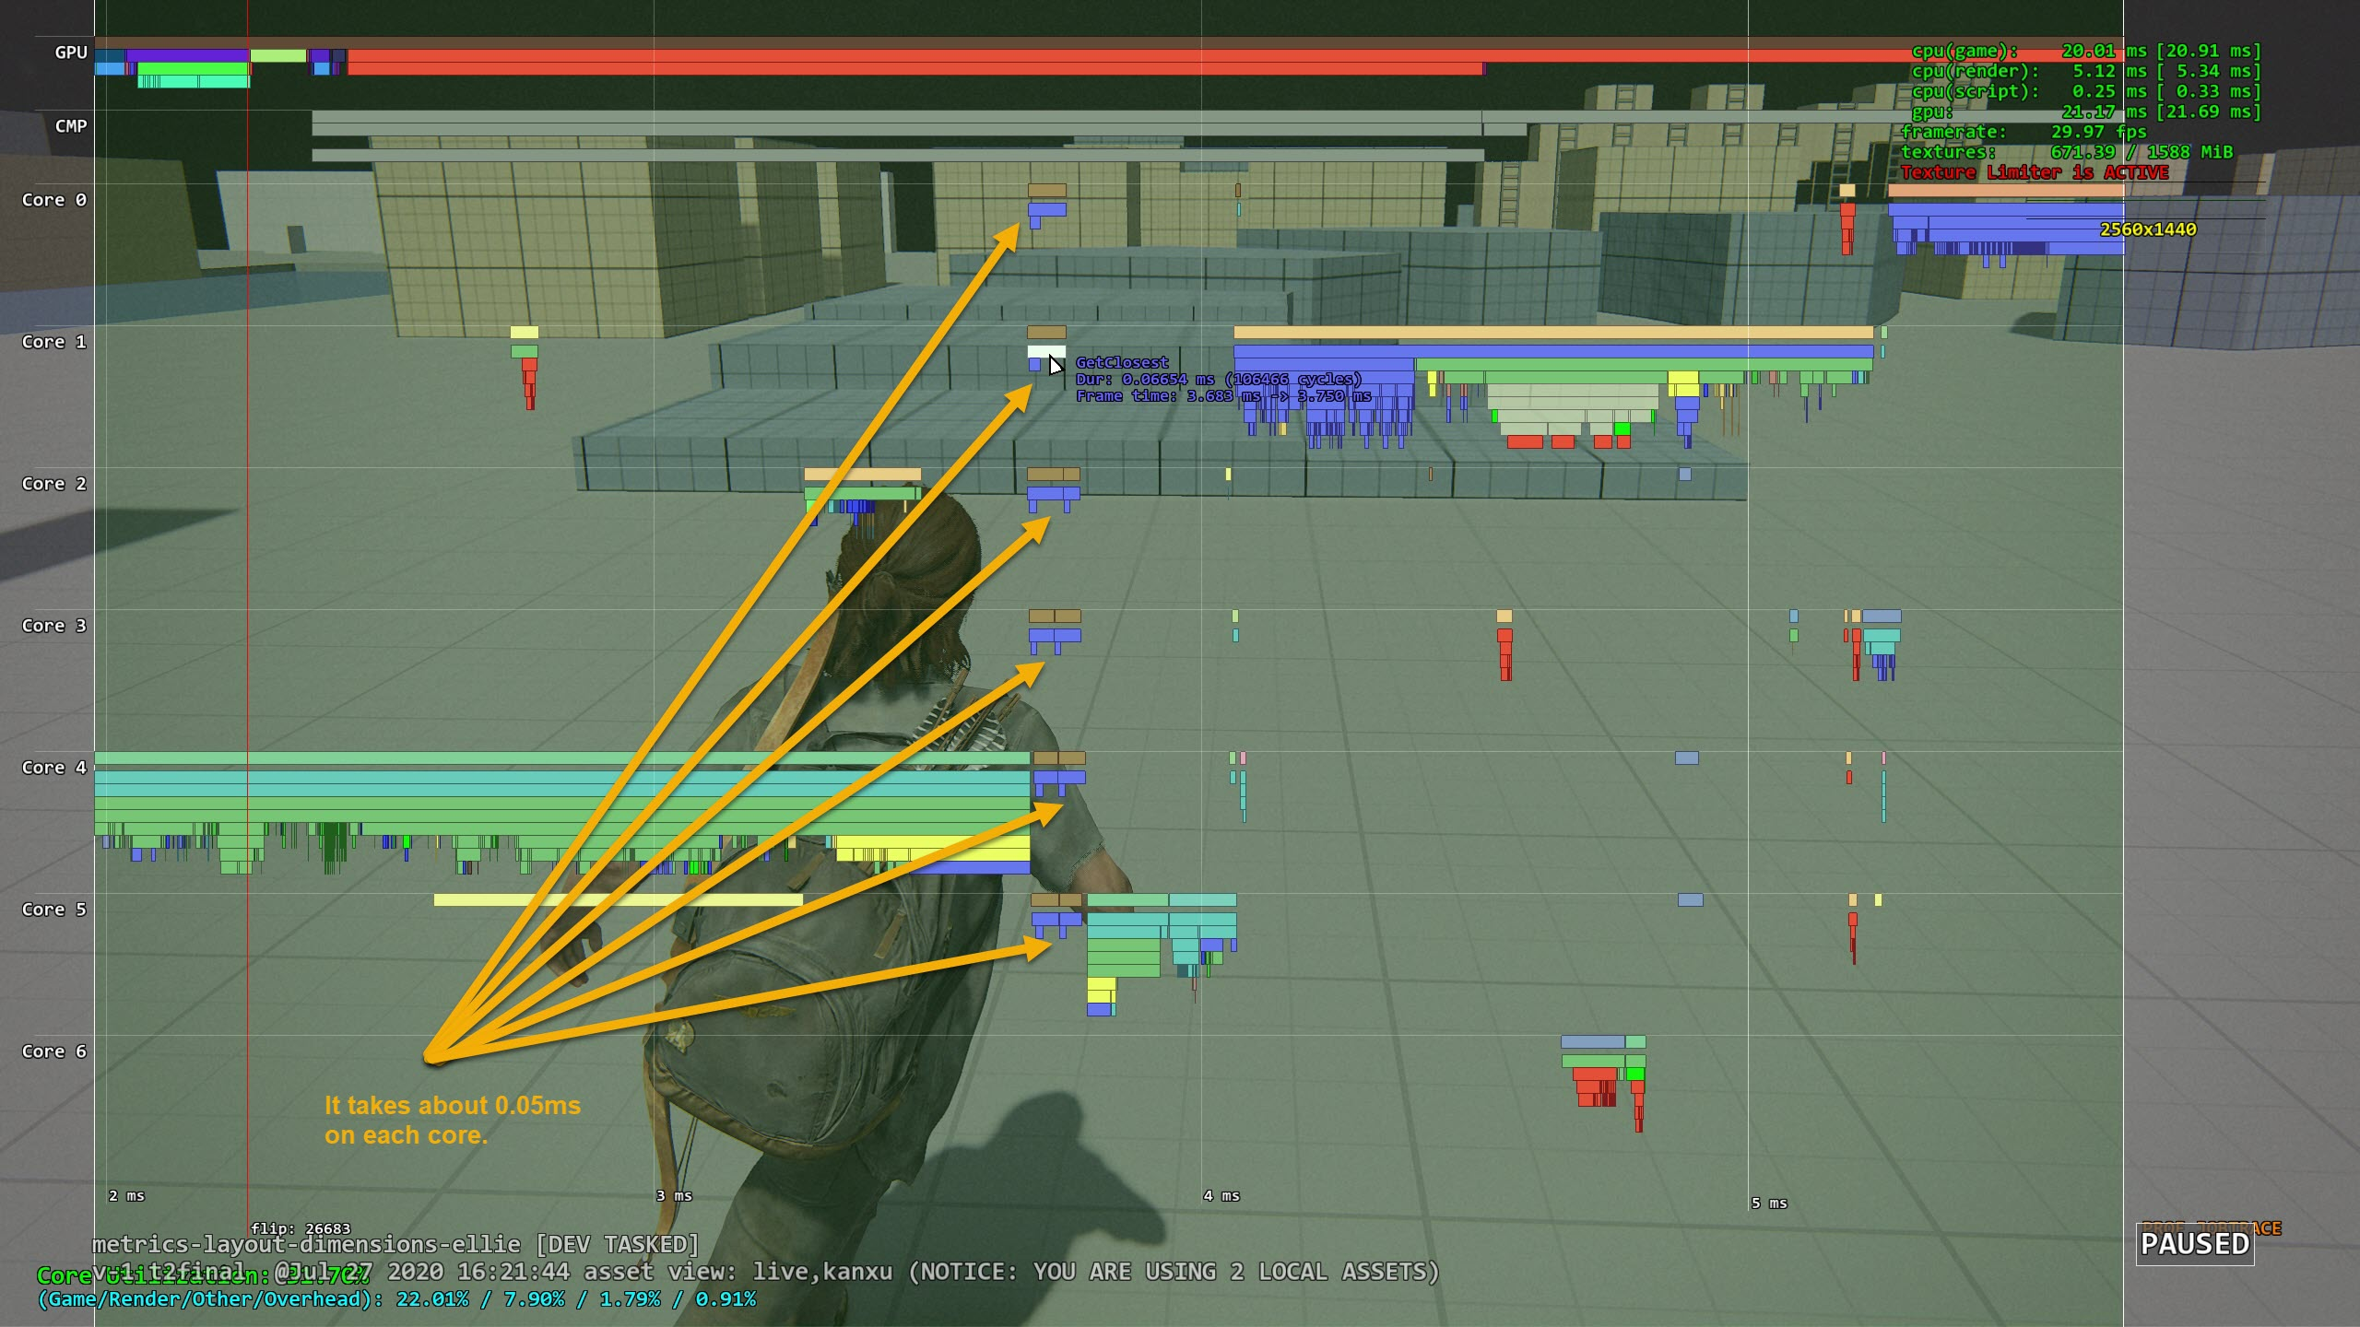
Result
Notes:
For npc, it takes 0.02ms since they have fewer poses.
We don’t have any problem running 1 player + 16 npcs at the same time.
Actually the number of npcs are bounded by path finding, which is much expensive operation.

Slide 43
Another optimization idea
Clustering poses using multiple dimension Kd-Tree
Maybe use PCA to reduce dimension first.

Slide 44
What else?
Character Movement driven by root motion or procedurally?
Procedural character rotation.
Scale animation playback speed to match desired speed.
Foot pinning IK.
Notes:
TLOU2 uses root motion to drive character’s movement. Some other games (especially online FPS), it can use procedural trajectory to move the character. And animation just tries to do best match.
Need procedurally rotate the character align to match the desired trajectory.
Foot pinning IK is very important, it fixes the foot sliding during procedural rotation and animation blending. We need evaluate feet speed and apply IK. A simple 2 bone IK will do the job.

Slide 45
Strafing MM Demo
Notes:
Let’s first see what motion matching can do:
TLOU2 is a 3rd person shooter game. Main character is always strafing.
This is our main character Ellie’s explore motion matching set:

Slide 46
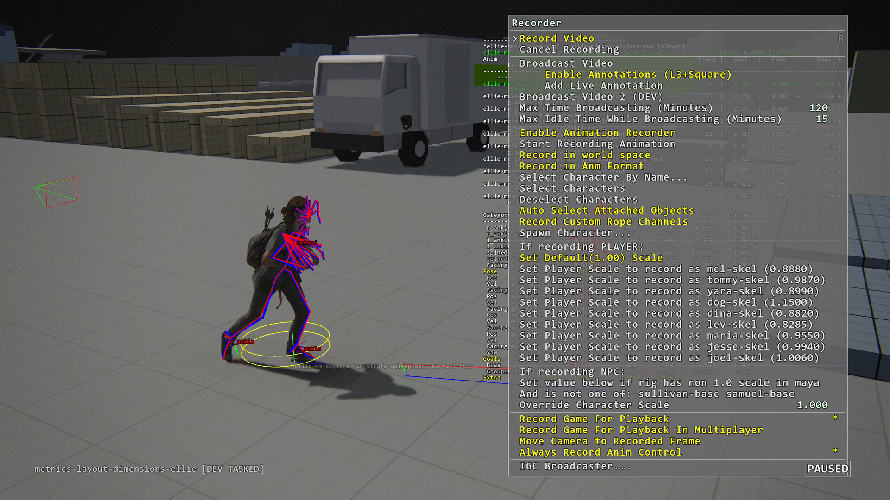
Debugger
Notes:
Debugger feature animators would like to have:

Slide 47
How about other animation system?
Motion matching suits locomotion naturally
The principle is applicable to other types of movement:
Melee
Hit reactions
Can be pose matching only
Consideration to use motion matching:
If it’s a core gameplay system?
Code complexity

Slide 48
Cons
Mirroring doubles CPU costs
Need a lot tweaking to get specific anim to play
Need extra work to sync with layers
Notes:
Overall we think MM pros is much bigger than Cons, so it’s worth it.

Slide 49
How does MM affect programmers?
Save a lot time coding locomotion state machine
Need good in game visualization debugger to explain why this pose is selected

Slide 50
How does MM affect animators?
Animation Clips are recommended:
Clips can remove redundant data
Need time to tweak pose weights and trajectory weights
No markup needed

Slide 51
Conclusion
MM is data-driven approach which handles transition, which produces better quality.
Motion matching will be next-gen animation standard.
MM means mentality shift to animators. They need take extra steps to manage “MM sets”.
Reference: Michael Buttner [Motion Matching - The Road to Next Gen Animation]

Slide 52
Q&A

